Slide 1

Our Summer at Citi Taking a STEP in the right direction
August 1, 2018
Notes:
Background
Rotation Assignment
Contributions and Accomplishments
Lessons learned

Slide 2

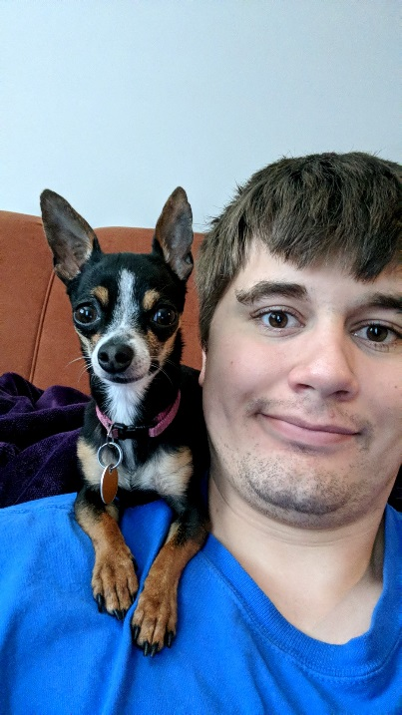
Alex Van Keulen
Hometown: Ghent, MN
College: Dakota State University
Majors: Computer Science and Cyber Operations
Hobbies: Python, Piano, and Puppies

Slide 3

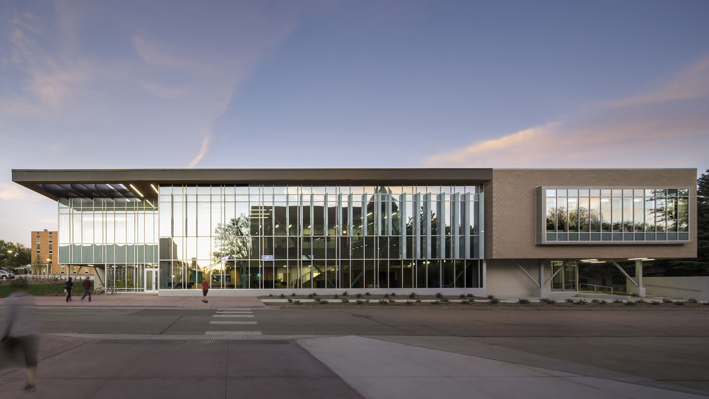
Dakota State University
Located in Madison, SD
Around 3,000 students
Focus in Cybersecurity
Recently Upgraded

Slide 4
What I Did
Team: Aces
Manager: Jeff Buller
Mentor: Steve Meyer
Purpose: Rewards

Slide 5

A Little About Aces
We work on Credit Card Rewards
Yep, that’s about it
It’s a complicated process
We get to code in…

Slide 6

COBOL
A Little About Aces
IBM Mainframe (Z14)
Very fun to work with! (Read: difficult)
Common terms associated with using the mainframe:
JCL, JobDoc, NDM, Modules, Geo-Segging, Procs, Cardlibs, ISPF, IOF, EZ editor, Return code 4, Job output, Bind codes, GDG, File Aid, RDz, etc…

Slide 7
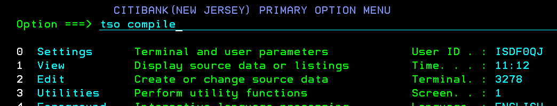
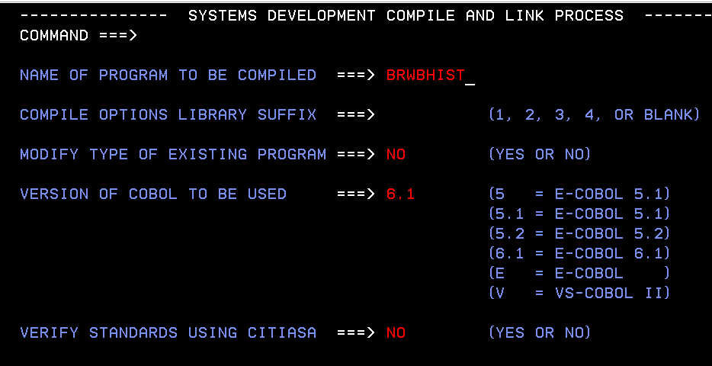
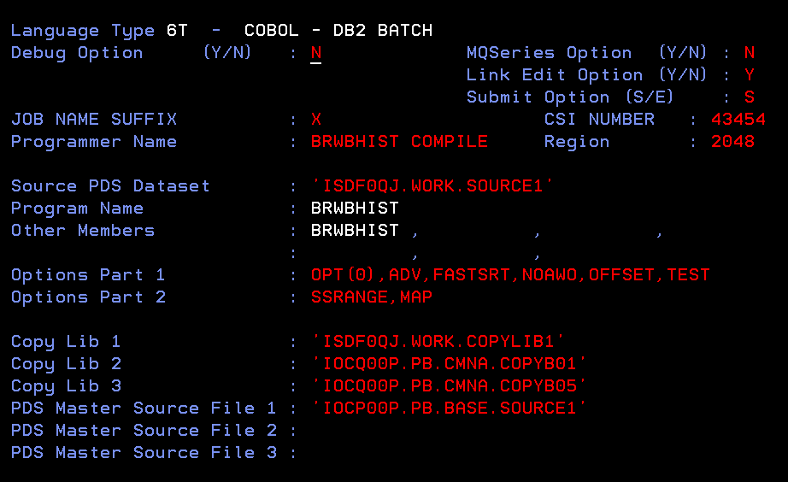
So you wanna compile?

Slide 8
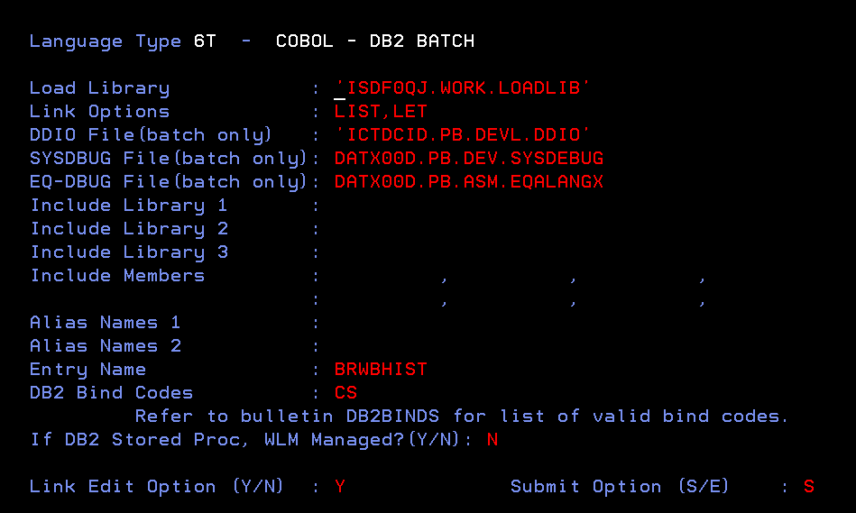

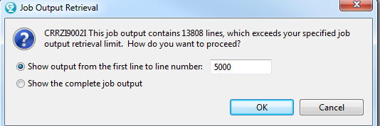
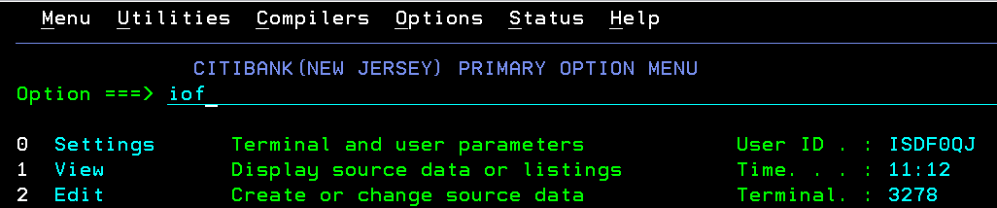
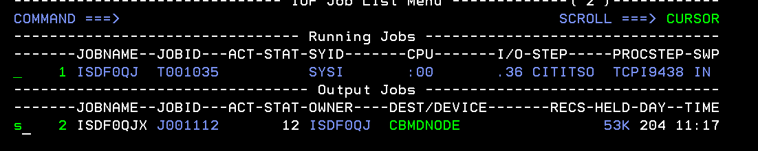
So you wanna compile?

Slide 9
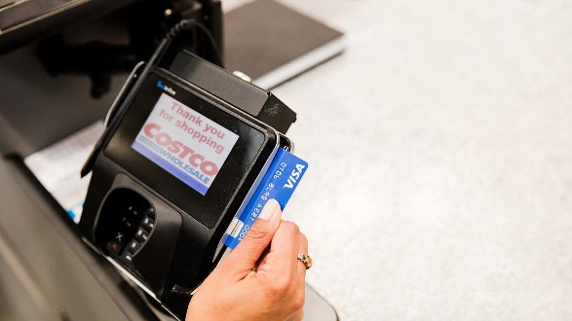
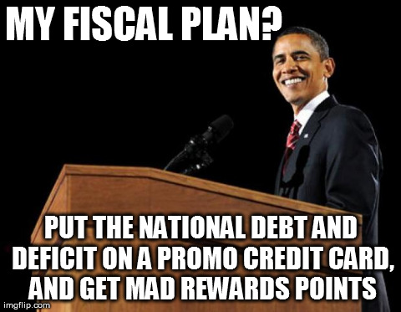
Rewards By transaction (RBT)
A Little About Aces
Step 1: Swipe your card
Unfortunately, coding isn’t that straightforward…
Step 2: Get Reward Points

Slide 10
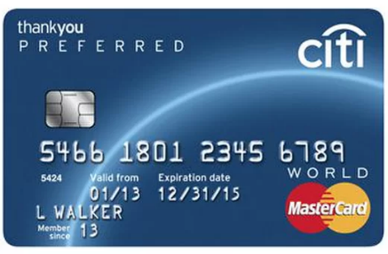
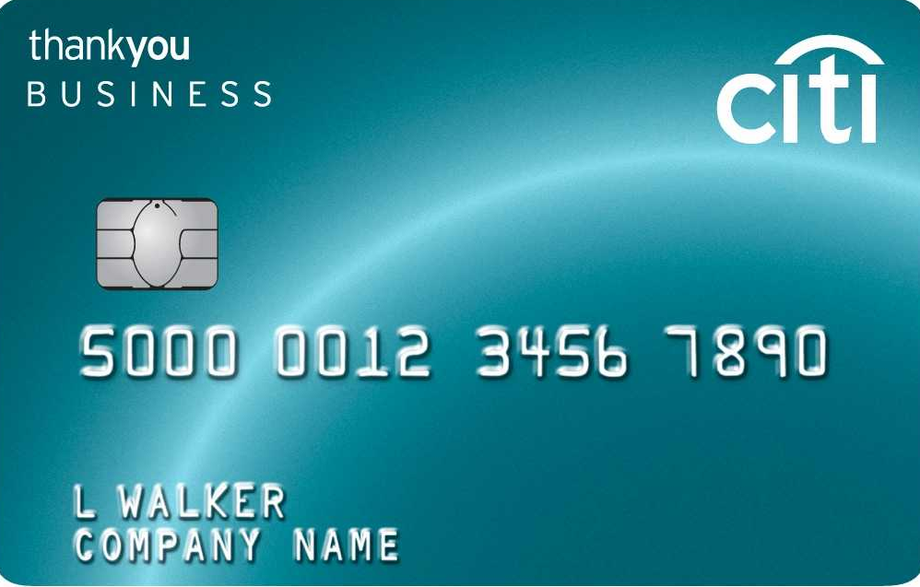

How I Contributed - Overview
RBT Geo-Segging
East
West

Slide 11
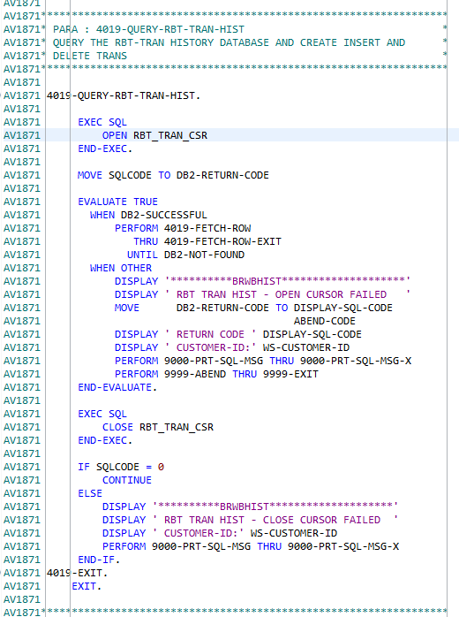

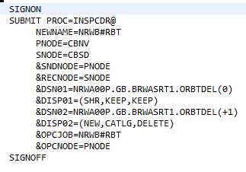
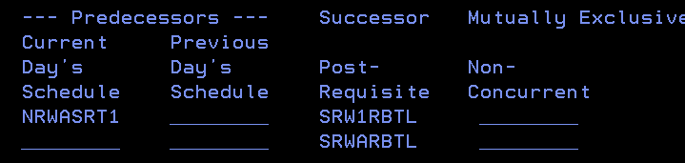
How I Contributed - Coding
RBT Geo-Segging
JCL
NDM
Module
JOBDOC

Slide 12
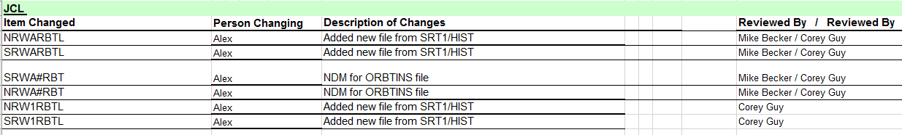
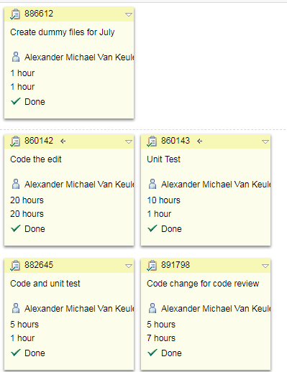
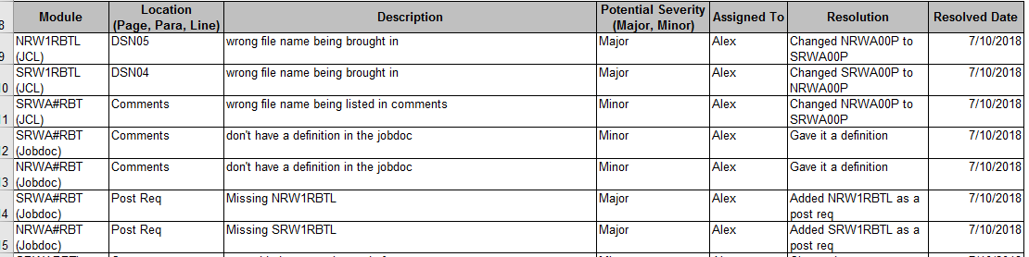

How I Contributed - Documentation
RBT Geo-Segging
IMP Checklist
Change Req
Logging Time
Code Review
Job Doc

Slide 13
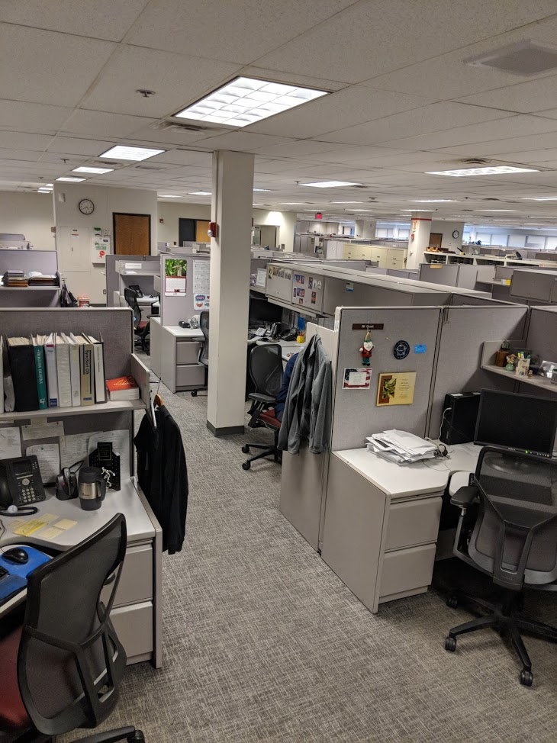
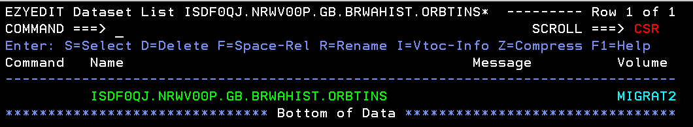
How I Contributed - Release
RBT Geo-Segging
I’ve never been so happy to see a line of green text before

Slide 14
How I Contributed - Road bumps
RBT Geo-Segging
Issues? You betcha
Currently no way to delete RBT fields off database
Shadow Jobs need to mimic this
No account has actually done this yet, and most likely won’t until October
I apparently suck at documentation

Slide 15
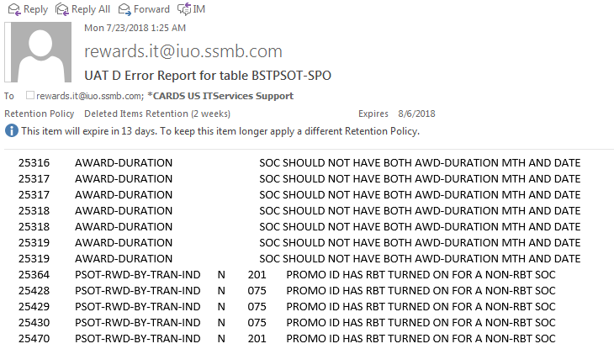
How I Contributed – Other Projects
Other Projects I Worked On
Validating Table Edit changes in User Acceptance Testing (UAT)

Slide 16
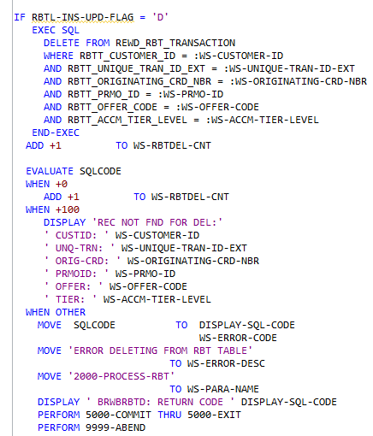
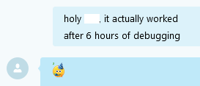
How I Contributed – Other Projects
Other Projects I Worked On
Create Process to Delete/Update RBT Tables

Slide 17
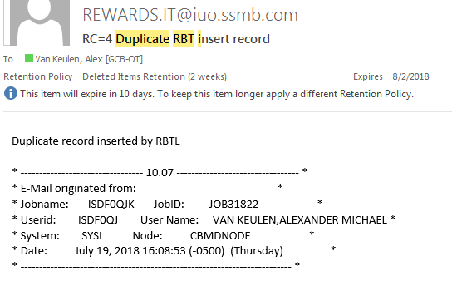
How I Contributed – Other Projects
Other Projects I Worked On
Modify a JCL to email team when an error occurs

Slide 18


How I Contributed – Other Projects
Other Projects I Worked On
Modify Behavior Logic For Billing

Slide 19
So What Did I Learn?
Tl;dr: A lot
CHANGE REQ
OEXD PACKAGES
FLOWCHARTS
PDS
IBM MAINFRAME
AGILE DEVELOPMENT
JOB SCHEDULING
DB2
COBOL
JCL
LOADLIBS
COPYBOOKS
EMAIL AUTOMATION
JOBDOC
GEO-SEGGING
RBT
RBE
JES
STAGING AND PROMOTING
IMP CHECKLIST
GDG
RDZ
RELEASE MANAGEMENT
RTC
CITI STANDARDS
ONE-TIMES
SOURCE COMPARES
DEBUGGING
FLAT FILES
VSAM
JOB REPORTS
DUMMY FILES
UNIT TESTING
SYSTEM HEALTH
UAT

Slide 20
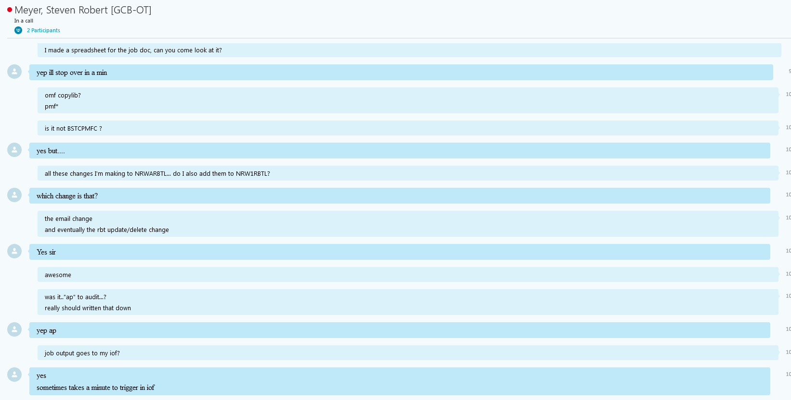
Acknowledgments
Huge thanks to Steve, who is always willing to help me out

Slide 21
That’s about all I got
Thank you!
Questions?

